Slide 1
Venezia Italian Gelato
An Analysis of Customer Reviews on Yelp.com

Slide 2
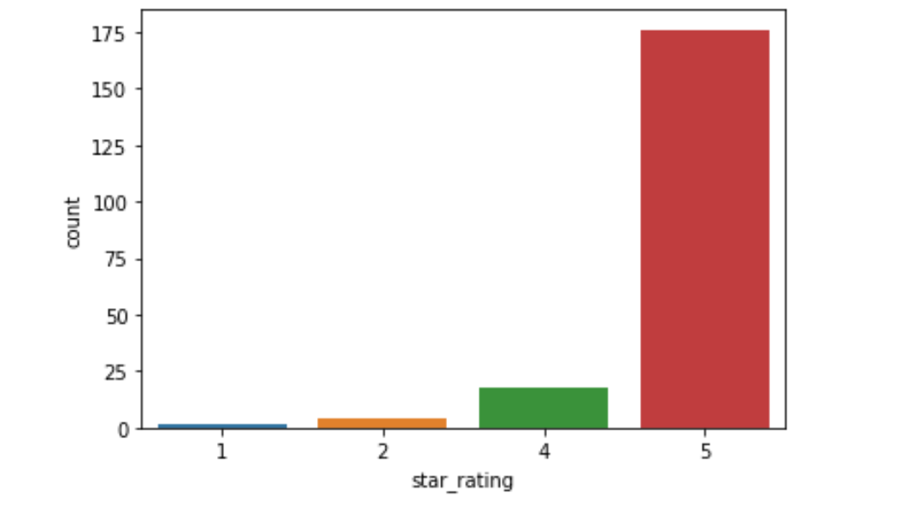
Number of Reviews Based on Star Rating
200 total reviews
No 3 star reviews
Percentage Breakdown
1-star : 1%
2-star: 2%
3-star: 0%
4-star: 9%
5-star: 88%

Slide 3
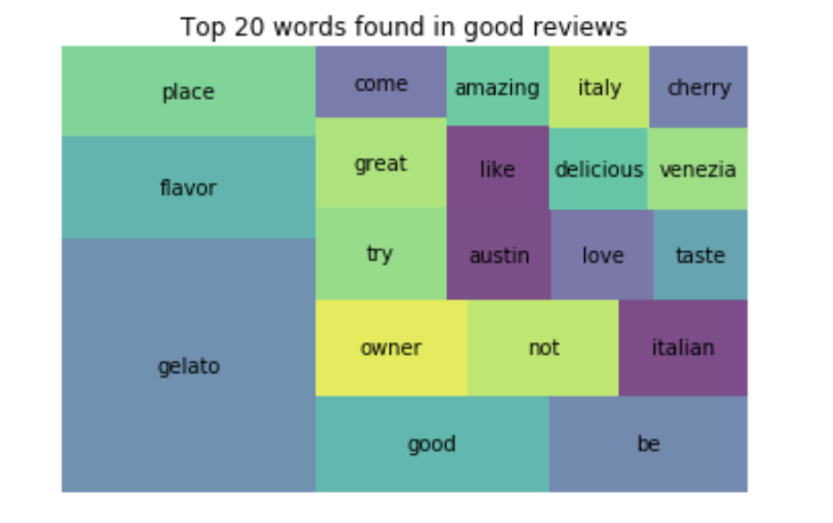
The Most Common Words Found in 4 and 5-star Reviews
Commonly mentioned:
Gelato
Tastes and Flavors
Italy/Italian

Slide 4
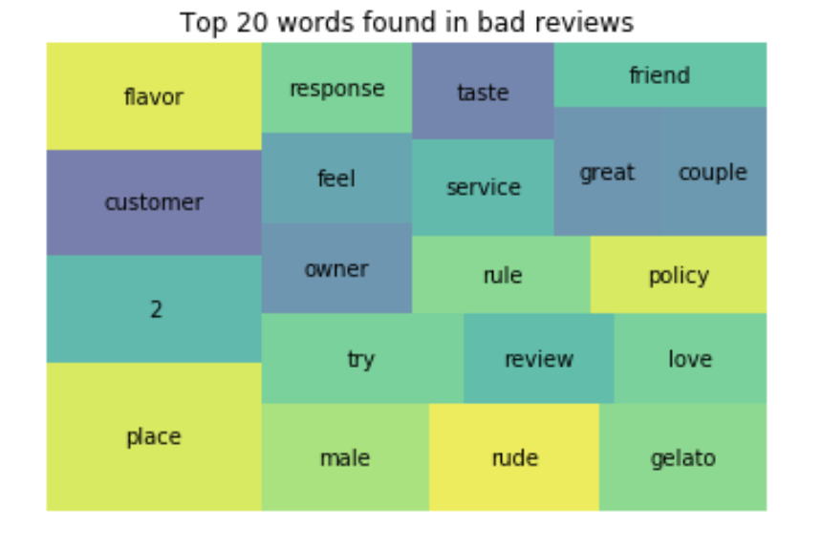
The Most Common Words Found in 1 and 2-star Reviews
Commonly Mentioned
Service
Gelato/Flavor
Owner
Policy/Rule

Slide 5
Recommendations
Continue:
Making great gelato flavors
Providing authentic Italian experience
Improve:
Focus on customer service
Evaluating gelato flavors based on popularity

